Slide 1

CALCULATOR PROJECT

Slide 2
Our Team
Lê Gia Huy
Nguyễn Thái Thanh Bình
Nguyễn Khương Duy
1952717
1952584
1952615

Slide 3
Overview
01.
02.
SOME RULES
03.
SIMPLE CALCULATOR
04.
Q&A

Slide 4
01
OVERVIEW

Slide 5
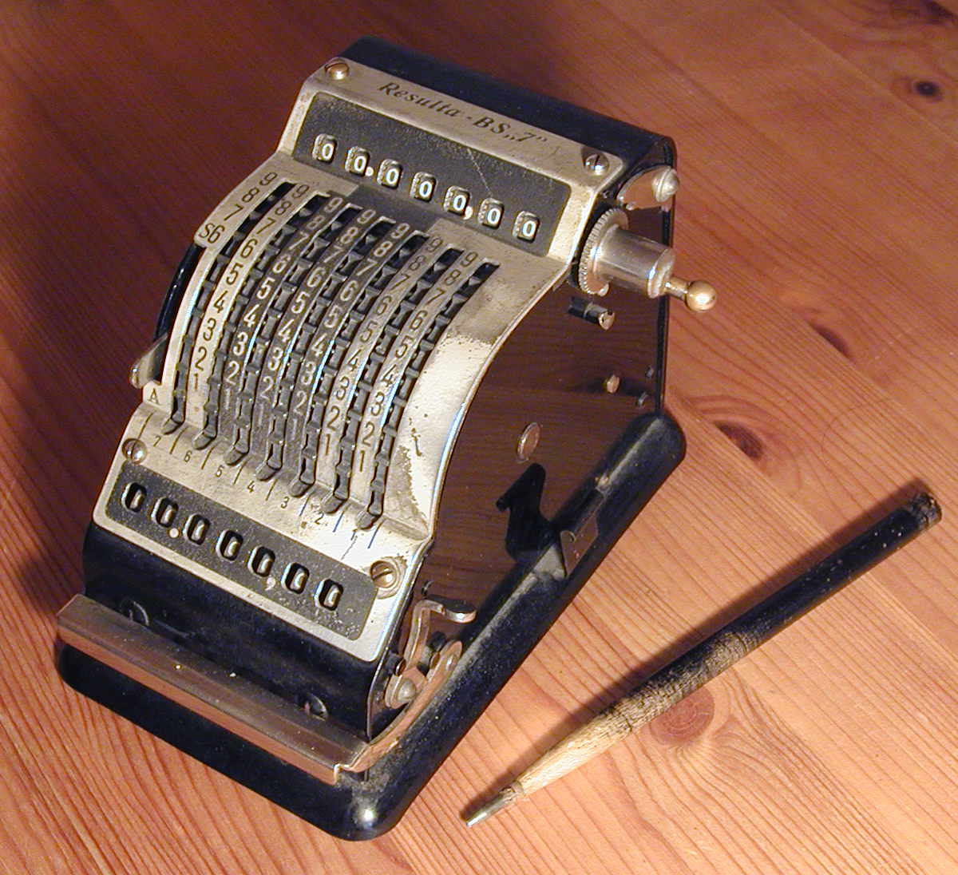
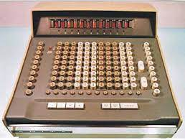
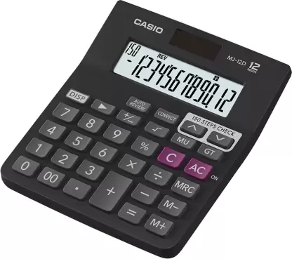
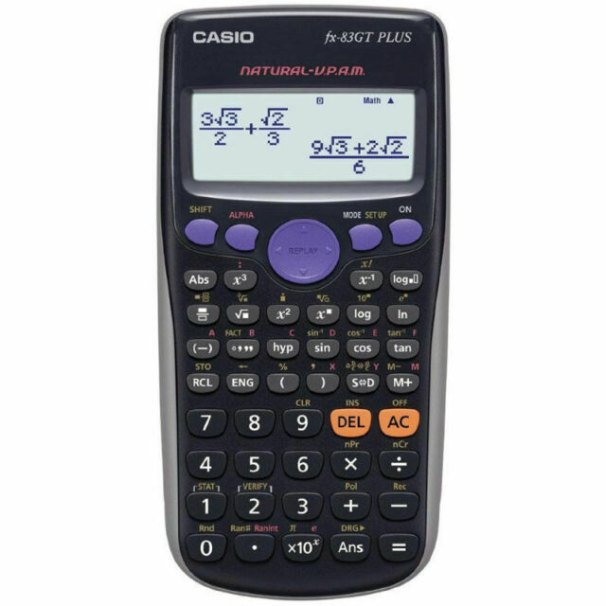
Calculator Overview

Slide 6
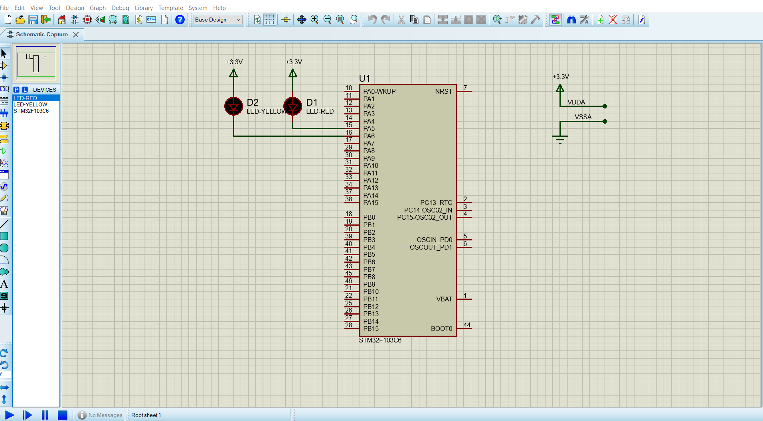
PROTEUS
The first schematic-based micro-controller simulation tool
The Proteus PCB Design and Layout tools have effectively met the needs of both business and education
The whole learning process takes place in software with the schematic capture module serving as the ’virtual hardware’ and the VSM Studio IDE module enabling firmware development and compilation
Running third party libraries and code examples that helps experiment with on-board peripherals such as USB

Slide 7
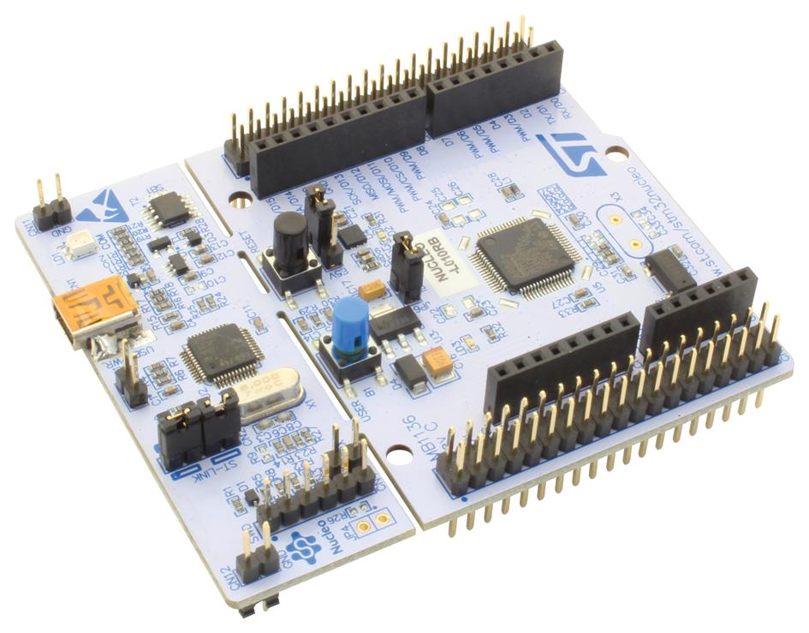
Microcontroller/STM32
ARM 32-bit Cortex™-M3 CPU (72MHz maximum frequency)
Memories:
16 or 32 Kbytes of Flash memory
6 or 10 Kbytes of SRAM
6 timers
6 communication interfaces:
I²C
USART
SPI
CAN
USB

Slide 8
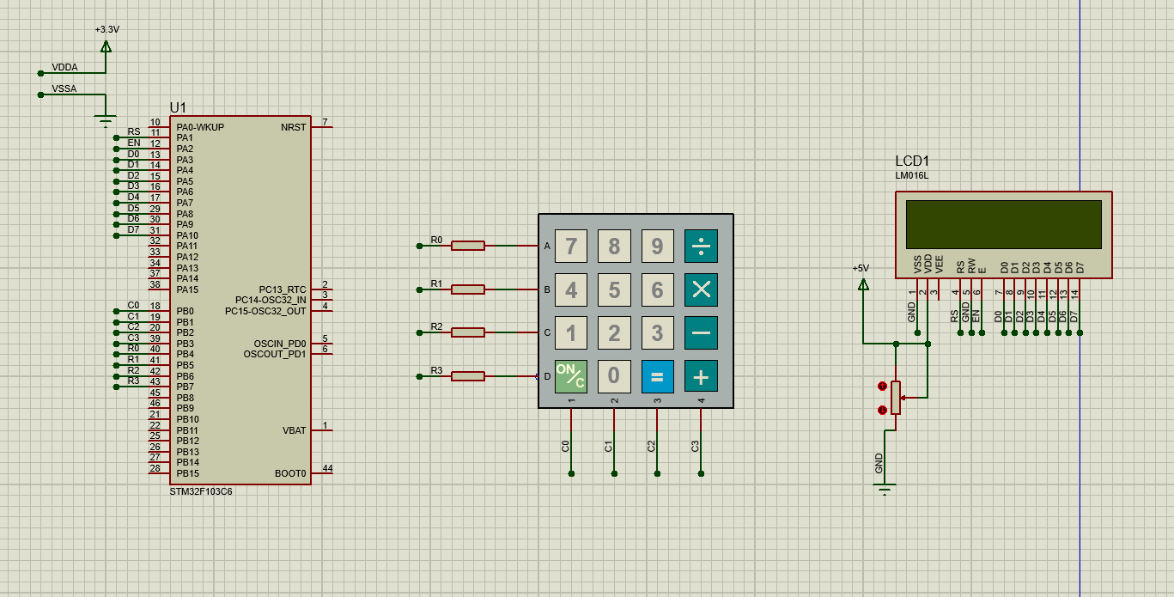
Schematic of Calculator

Slide 9
02
SOME RULES

Slide 10
Some rules for our Calculator
The math expression must be less than 16 characters, including digits and math notation
The result must be followed the data type of integer (-10⁹, 10⁹)
The calculator only receive one math (or one operator) at a same time, except negative number
To perform new calculation, you have to press ON/C
If there are more than one operator (max is 2 operators), it will receive the last operator.
When the LCD Display "error" or "math error", the user has to press button ON/C

Slide 11
03
SIMPLE CALCULATOR

Slide 12
Part 1
Input of calculator
Part 2
The logical
Part 3
Output of calculator

Slide 13
INPUT OF CALCULATOR

Slide 14
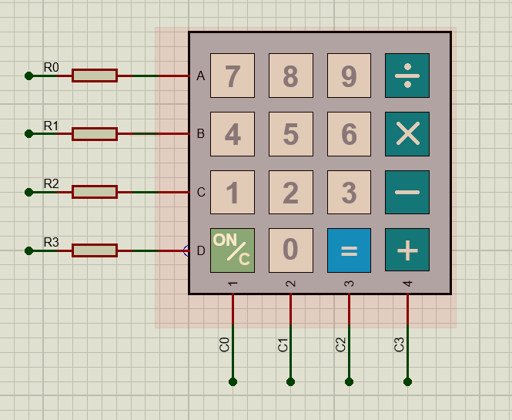
Keypad 4x4

Slide 15
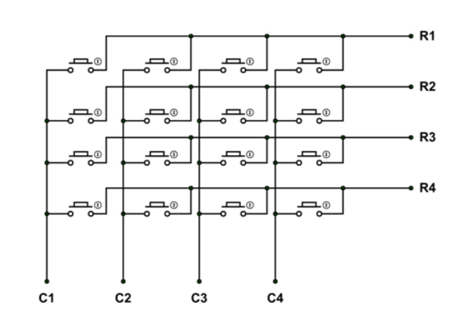
Schematic of 4x4 keypad

Slide 16
Get a character from keypad
Step 1:
Declare an array of character returned when a key is pressed
Step 2:
Write 4 pins row HIGH and 4 pins column LOW concurrently
Step 3:
If a key is pressed, column and row are connected and the value of row is LOW
Step 4:
Return a character corresponding to that column and row

Slide 17
OUTPUT OF CALCULATOR

Slide 18
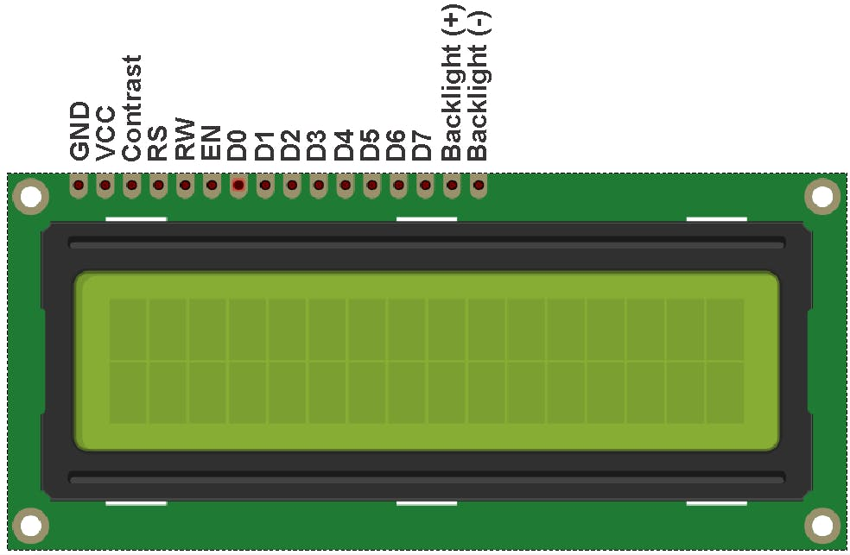
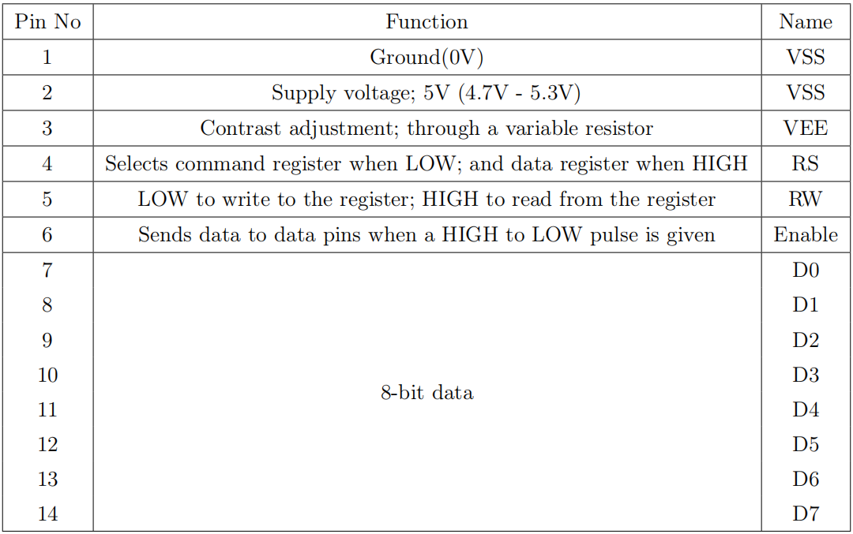
LCD 16x2

Slide 19
Display on LCD
Function 1
void LCD_Init()
Function 2
void LCD_Send_CMD(char cmd)
Function 3
void LCD_Send_Data(char data)
Function 4
void send8bitstoLCD(char vee)
Function 5
void LCD_Put_Cur(int row,int col)

Slide 20
LOGIC OF CALCULATOR

Slide 21
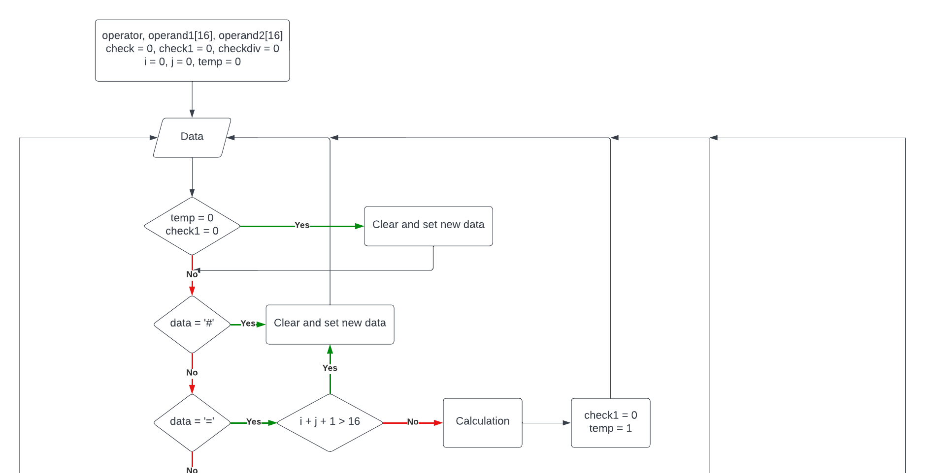
LCD_add_To_String() function

Slide 22
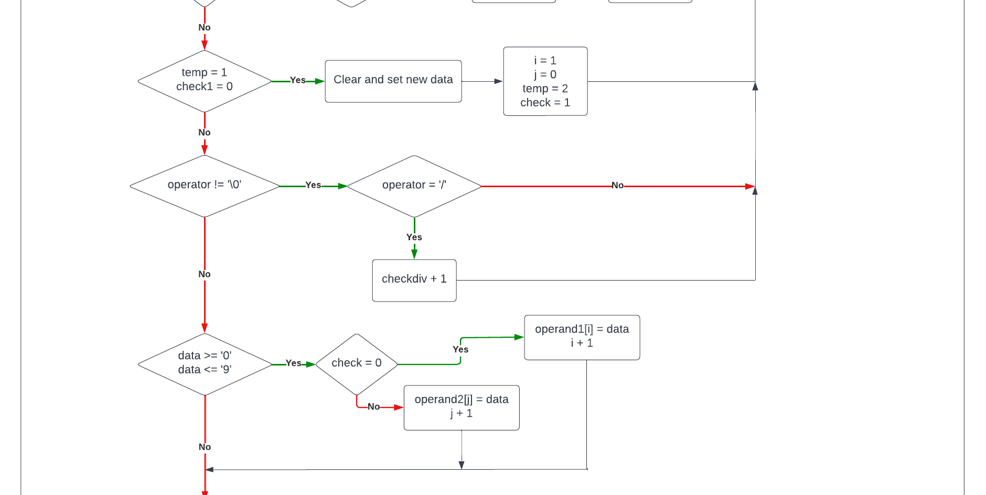
LCD_add_To_String() function

Slide 23
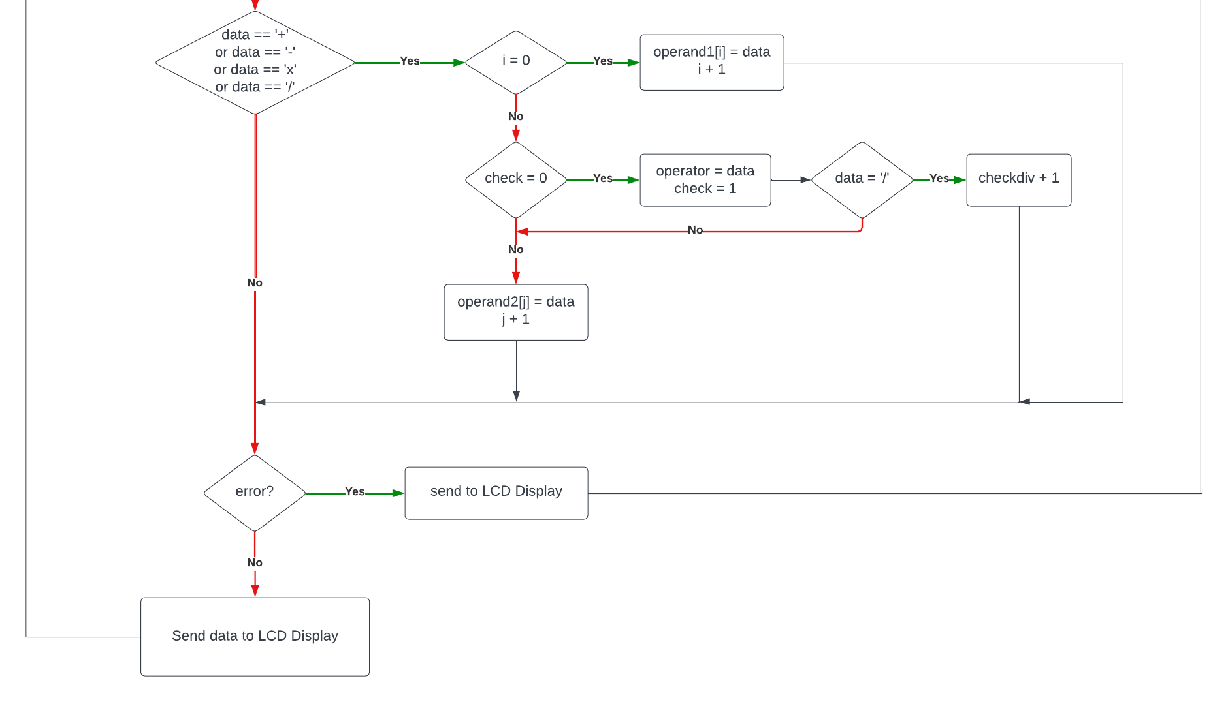
LCD_add_To_String() function

Slide 24
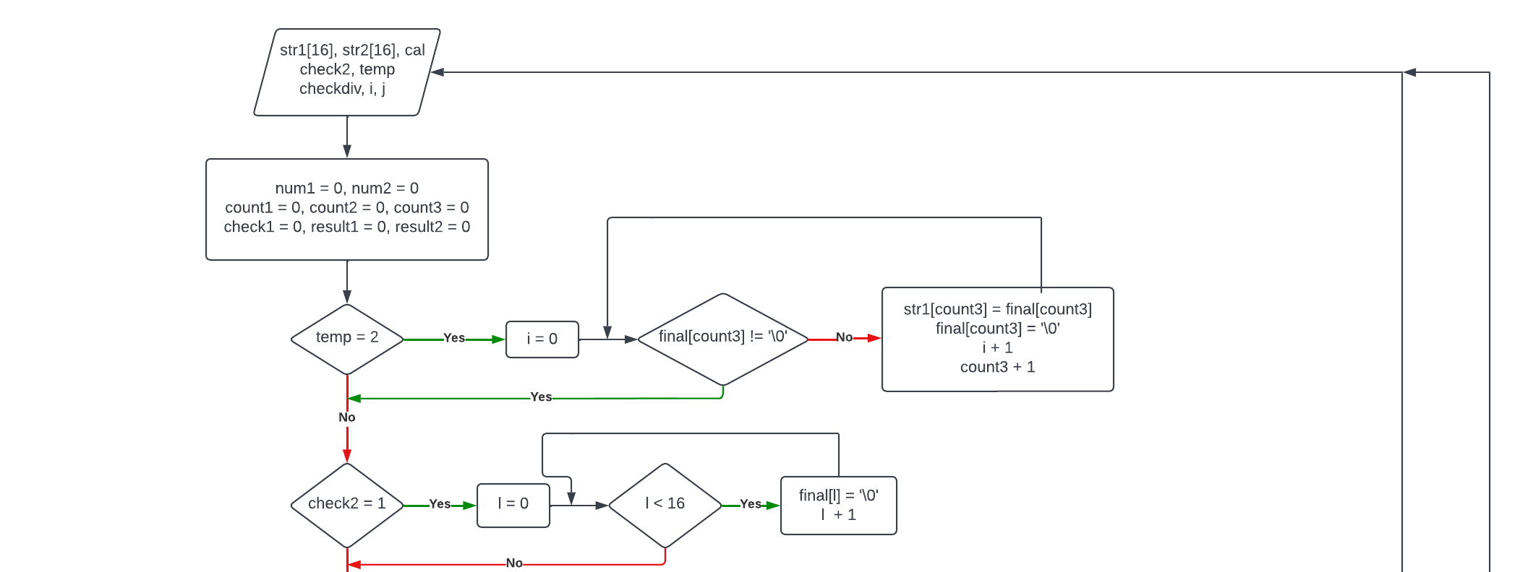
LogicCode() function

Slide 25
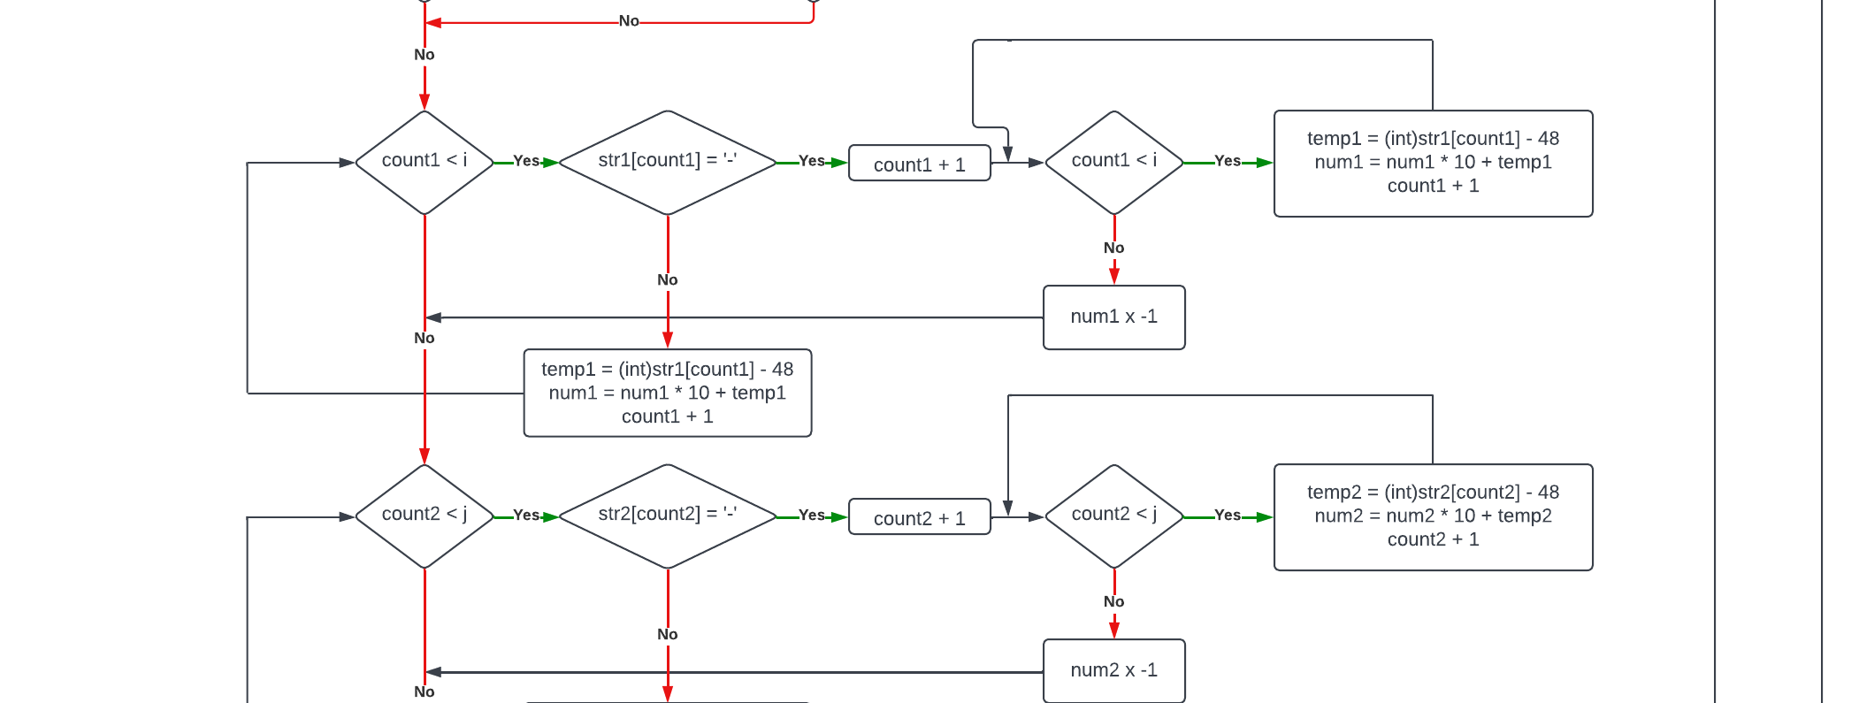
LogicCode() function

Slide 26
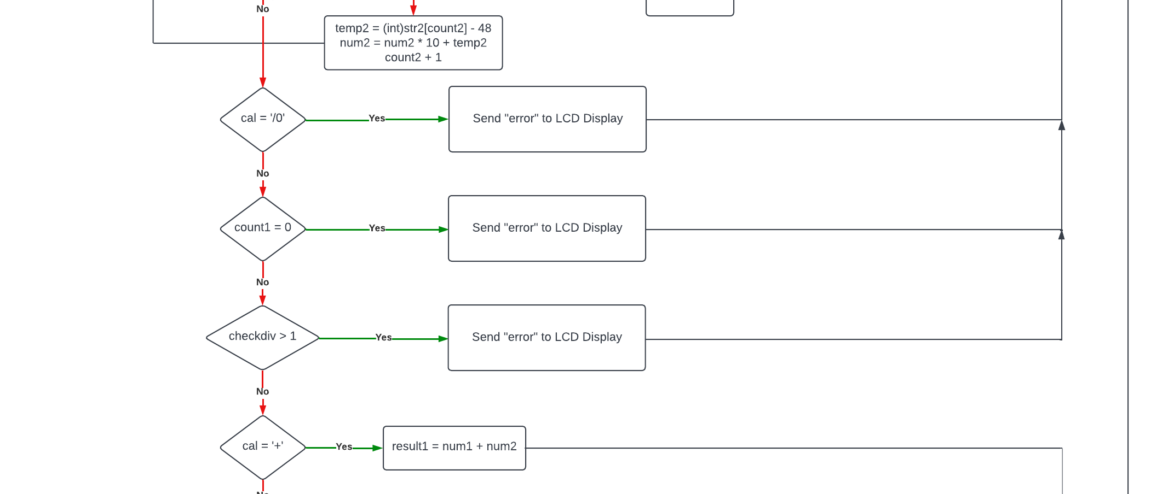
LogicCode() function

Slide 27
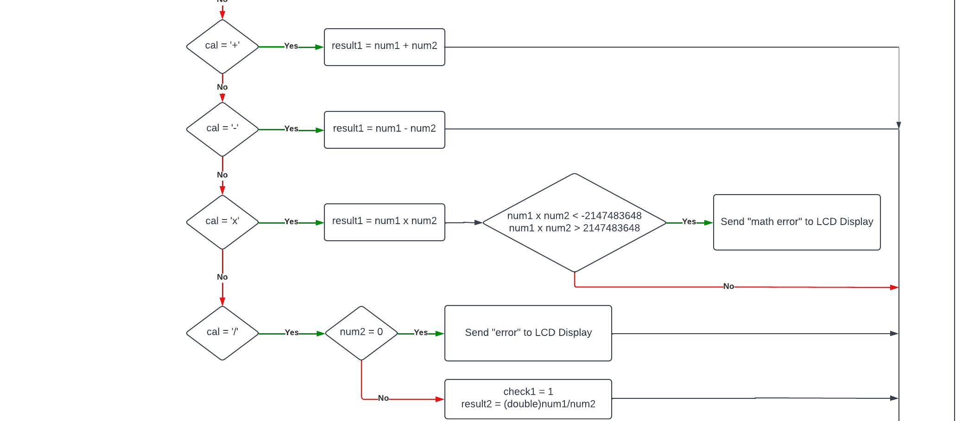
LogicCode() function

Slide 28
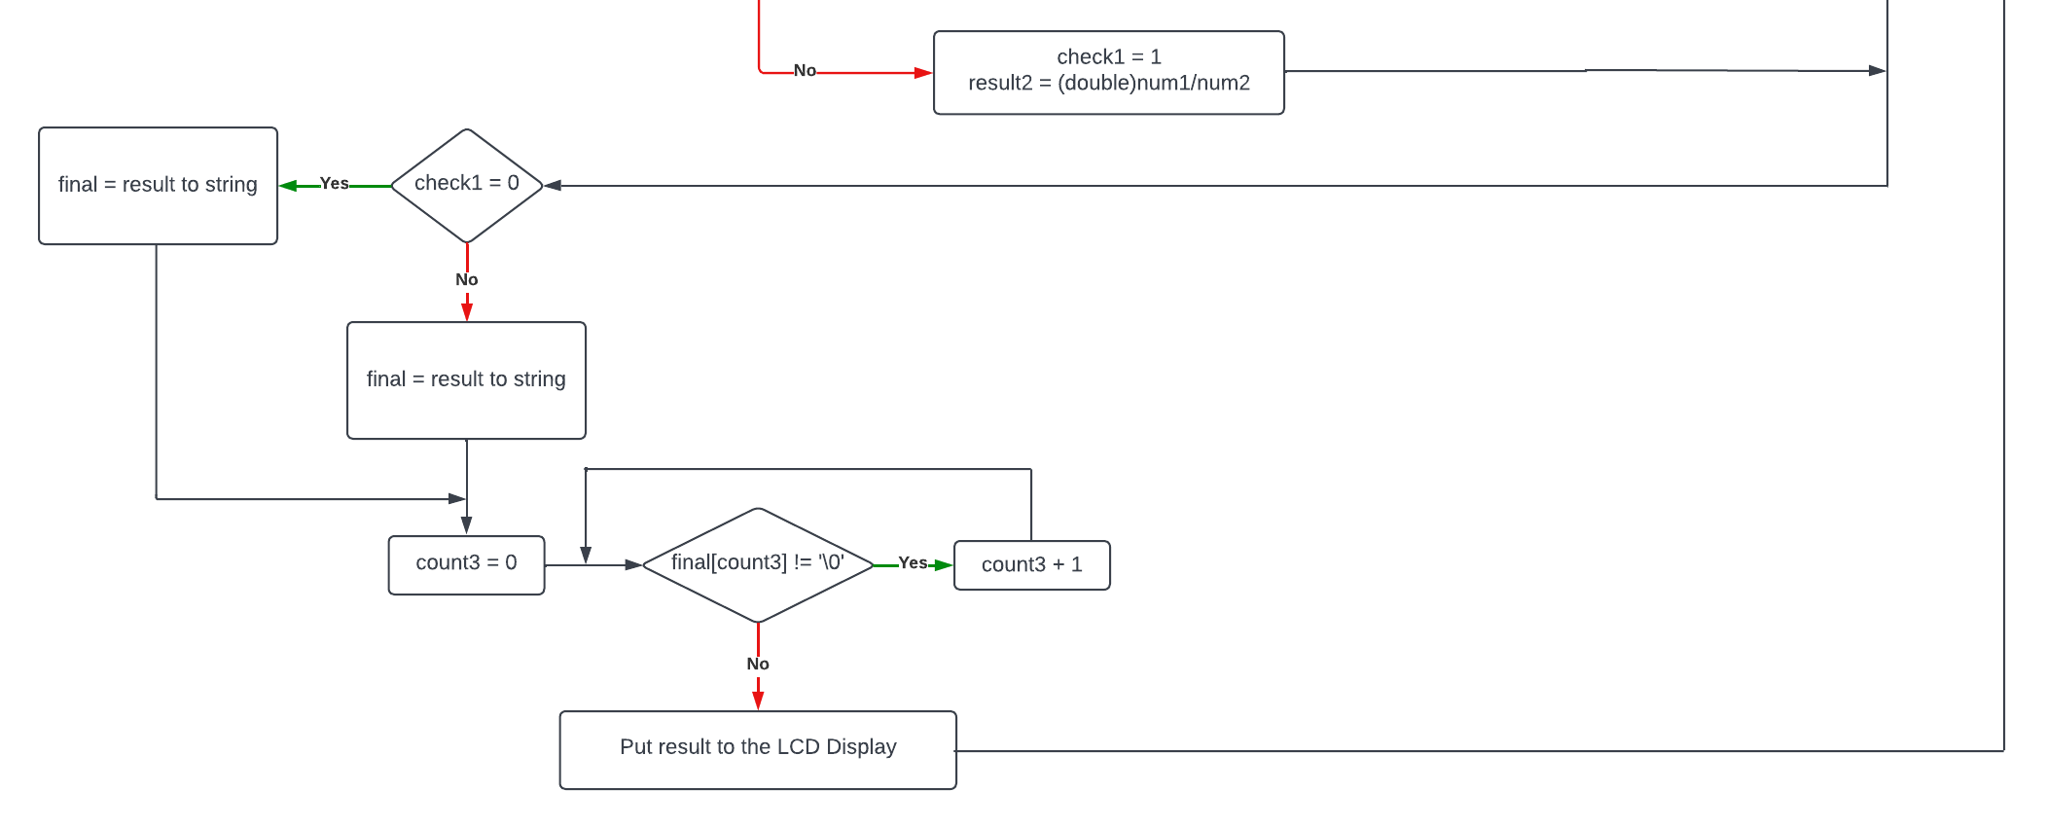
LogicCode() function

Slide 29
THANKS FOR LISTENING

Slide 30
Q & A

